Slide 1
Safety, quality, and productivity
Safety, quality, and productivity are inextricably linked
When organizations put better care into maintaining their safety, quality, and productivity, they are also better able to serve their customers and protect their employees
Too often, businesses will see safety, quality, and productivity as interfering with each other, while they actually operate in concert.
Organizations must not think of safety as a nuisance, but rather as an incredibly important component to business success

Slide 2
Safety
Improves quality and productivity
When operations are unsafe, they aren’t well-managed
Employees will not be motivated nor mindful, and employee churn will be far greater
Quality and productivity both suffer when employees are under stress, unsatisfied, or unable to complete their mission
But when businesses are safe, it frees up employees to focus on their quality and their productivity
The safer the organization is, the less frequently the organization will experience large scale disruption

Slide 3
Quality
Improves safety and productivity
Safety is a measure of conscientiousness and proactiveness
High quality work means better results and better products
The higher quality the work, the fewer reworks are needed, and the greater overall productivity is
When quality is high for a business, it can be assumed that standards for the business are generally high, including safety equipment, safety software, and safety processes

Slide 4
Productivity
Improves safety and quality
Carelessness is often what begets safety issues
With the appropriate (and productive) safety processes, safety can be improved, and quality can be improved as well
The more productive employees are, the less likely they are to cut corners on things like safety processes
The more productive they are, the more likely they are to put extra attention into the quality of their work

Slide 5
Traditional Barriers to Safety, Quality, and Productivity
It’s easy to see that safety improves business outcomes
Dangerous operations lead to lost time, injured employees, and a loss of morale
Nevertheless, many organizations fear that additional safety processes can take time and money
While true, it’s time and money well spent; it’s better to spend a small amount for preventative care than a large amount for an emergency

Slide 6
Traditional Barriers to Safety, Quality, and Productivity
In terms of quality, the primary issue is often expediency
Companies may feel they have to choose between fast, cheap, or high-quality
When companies are forced to reduce costs (cheap) and produce quickly (fast) they need to sacrifice quality
But sacrificing quality actually ends up driving up time and costs; unsatisfied customers demand reworks, which can often be upwards of three times the original budget

Slide 7
Traditional Barriers to Safety, Quality, and Productivity
Productivity must never be seen to be at odds with safety or quality
Organizations may feel that safety and productivity are mutually exclusive, and that it’s difficult to maintain a productive office

Slide 8
Safety, quality, and productivity
A productive workplace offers a wide range of benefits to the company, employer, and employees:
  Increased Performance: Workplace performance and productivity go hand in hand. When performance is increased, so does productivity. Also, increasing productivity in the workplace can motivate employees to put in more effort, thus increasing performance.
  Improved Employee Engagement: Efficient and effective productivity in the workplace encourages employees to be more involved in their work. Additionally, such employees are always ready to take on new tasks and often aim to be the best at what they do.

Slide 9
Safety, quality, and productivity
  Greater Fulfilment: Increased productivity can give employees and employers a sense of fulfilment and purpose. Those in the workplace can be happy or unhappy based on the level of productivity.
  Promotes a Healthy Work Culture: A productive workplace can improve employee wellbeing. Plus, when people achieve goals as a team, they are likely to form professional work relationships.
  Better Revenue Generation: Long-term productivity in the workplace can maximize company profits. Organizations that are productive offer better services and can easily turn a profit.

Slide 10
Accident
The ordinary definition of the word “Accident” as derived from lexicons is an unforeseen of an unexpected event.
The American Safety council has defined accident as “that occurrence in a sequence of events which usually produces unintended injury, death or the property damage.
Heinrich has defined accident as “an unplanned and uncontrolled event in which the action or reaction on an object, substance, person or radiation result in personal injury”.

Slide 11
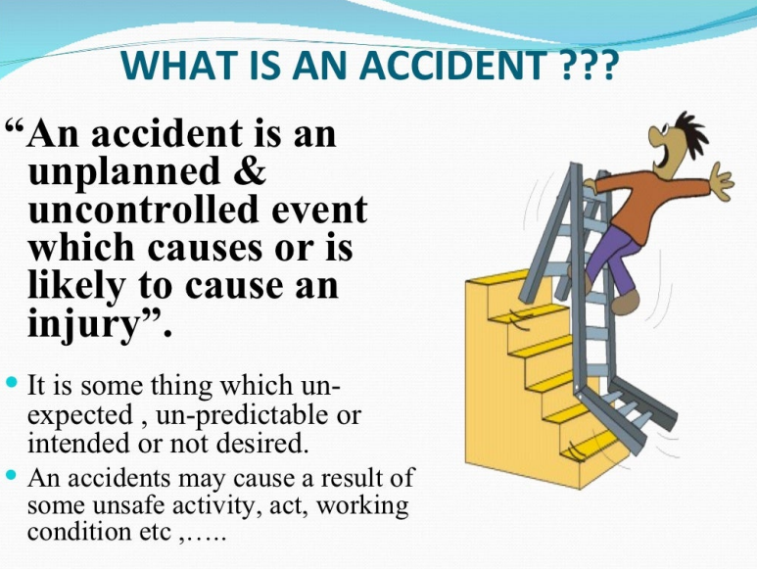

Slide 12
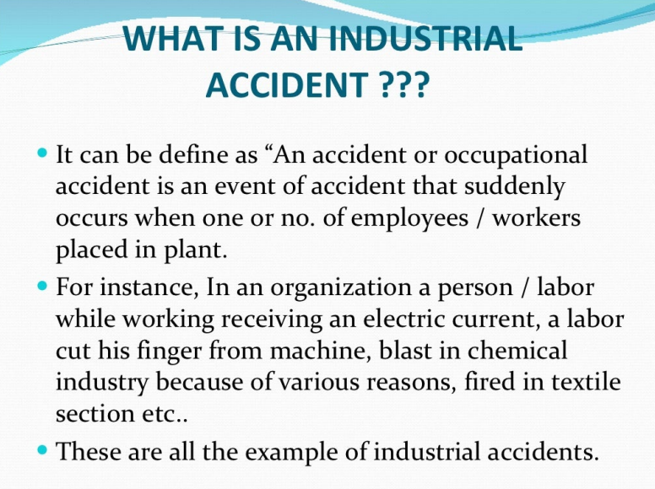

Slide 13
Injury
An injury or illness is an abnormal condition or disorder. Injuries include cases such as, but not limited to, a cut, fracture, sprain, or amputation. Illnesses include both acute and chronic illnesses, such as, but not limited to, a skin disease, respiratory disorder, or poisoning.

Slide 14
Injury (Cont.…)
“Injury” means mental or physical harm to an employee caused by accident or disease, and also means damage to or destruction of artificial members, dental appliances, teeth, hearing aids and eyeglasses, but, in the case of hearing aids or eyeglasses, only if such damage or destruction resulted from accident which also caused personal injury entitling the employee to compensation therefore either for disability or treatment.

